Slide 1

Chapter 3
Logical Reasoning and Problem-Solving in Science
Computing Science for Science Teaching
วิทยาการคำนวณสำหรับการสอนวิทยาศาสตร์
CHEWA THASSANA
Center for AI Powered Digital AgriPhysics Research

Slide 2

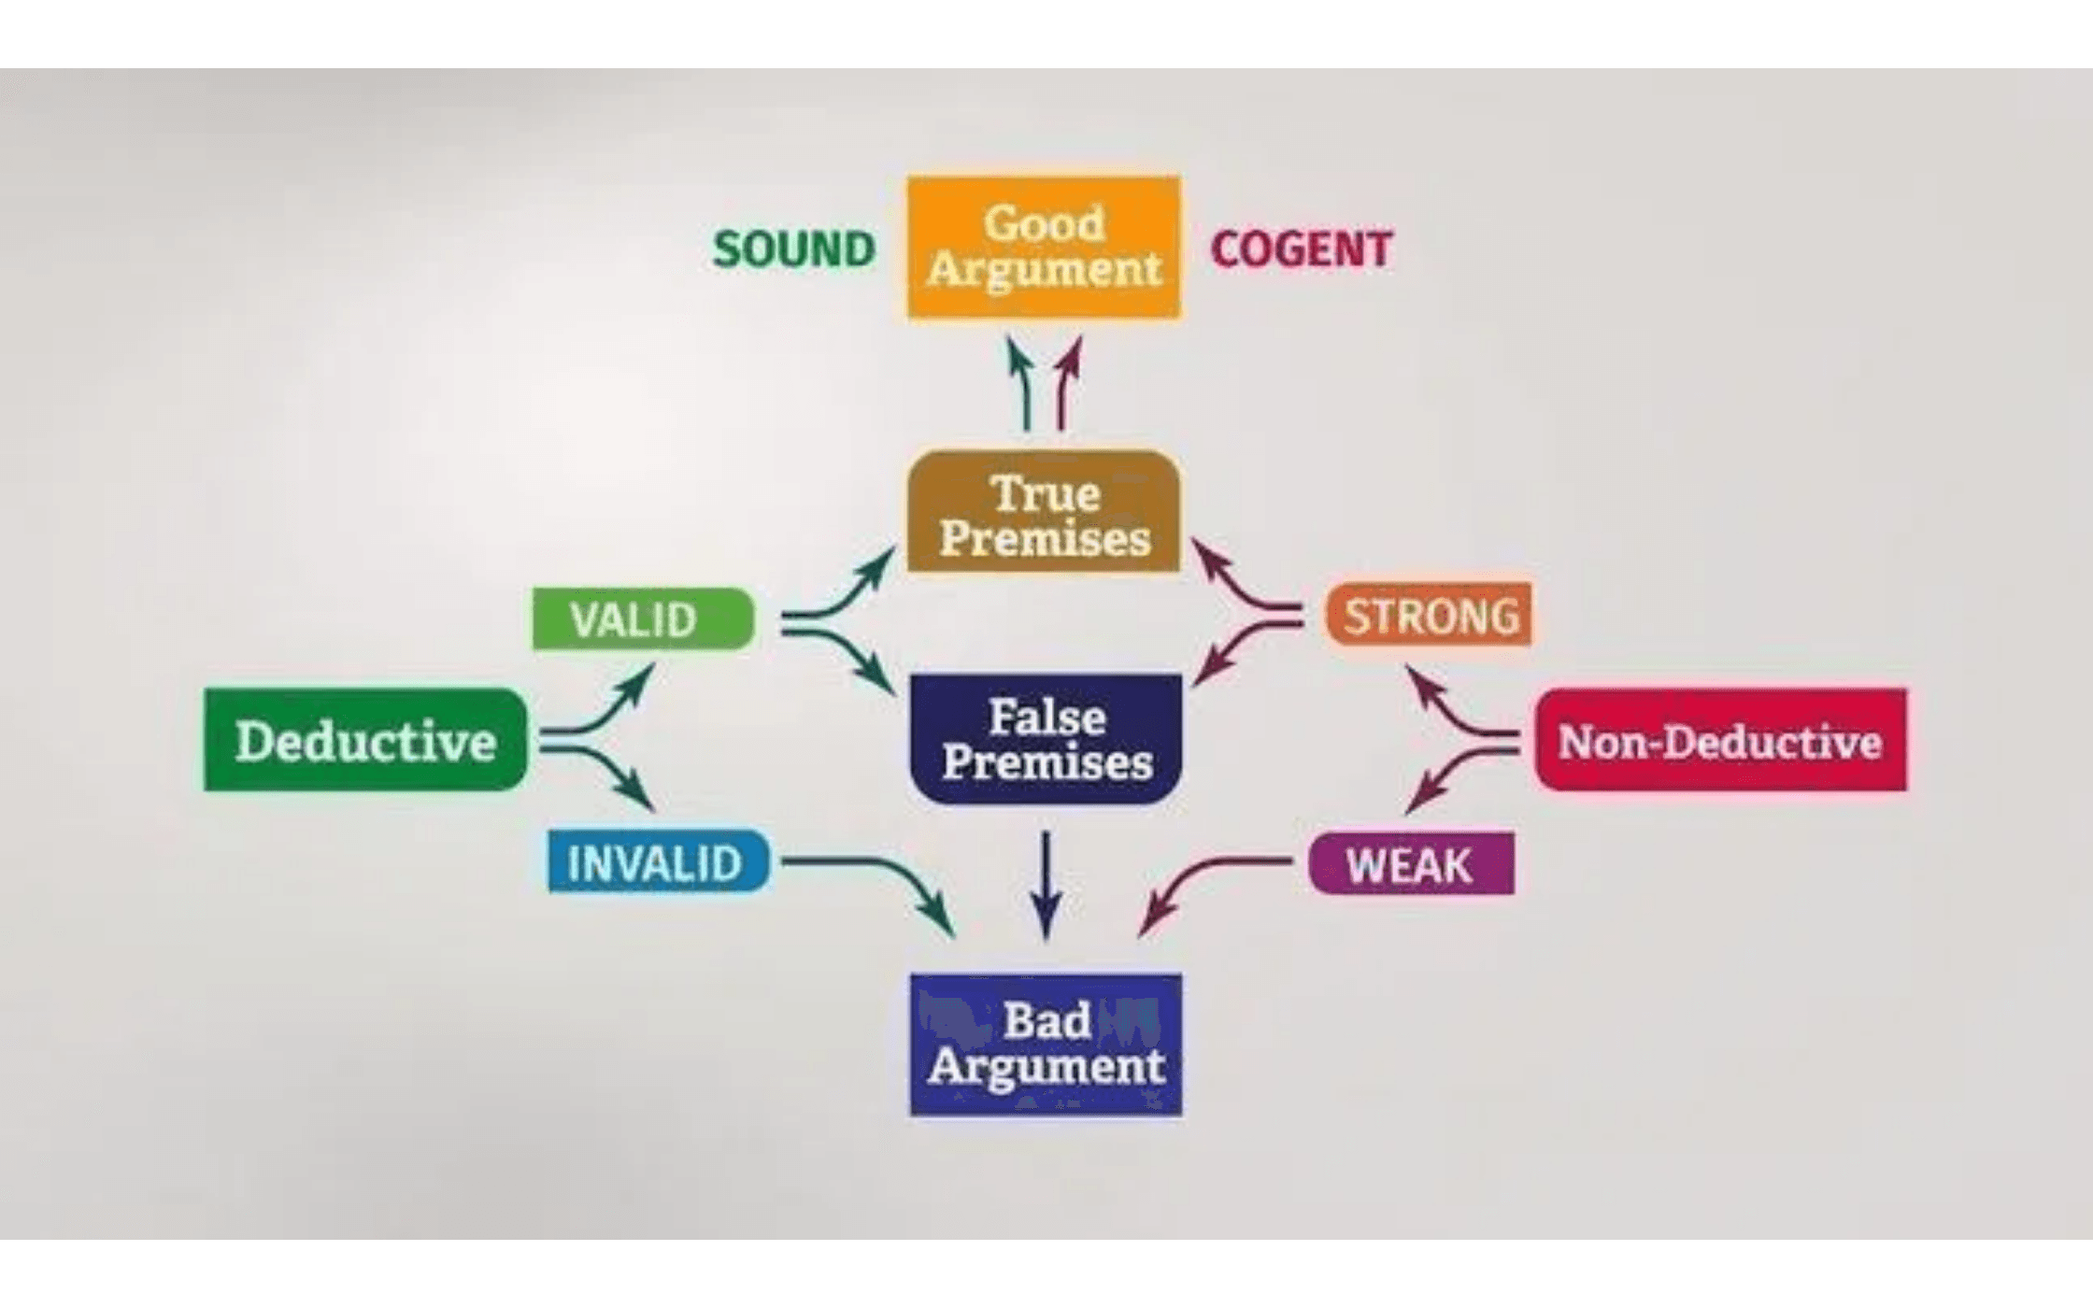
Logical Reasoning: The Bedrock of Scientific Thought
Definition
Logical reasoning is the process of using a systematic series of steps to arrive at a conclusion, whether through deduction (general to specific) or induction (specific to general).
The Scientific Process
Observations lead to questions
Logical reasoning formulates testable hypotheses
Experimental design relies on logical control of variables
Data interpretation requires rigorous logical analysis
Scientific arguments demand clear, coherent reasoning
Example
A scientist observes plants exposed to more sunlight grow taller. They logically infer that sunlight is a growth factor and hypothesize that increasing sunlight will increase plant height.

Slide 3

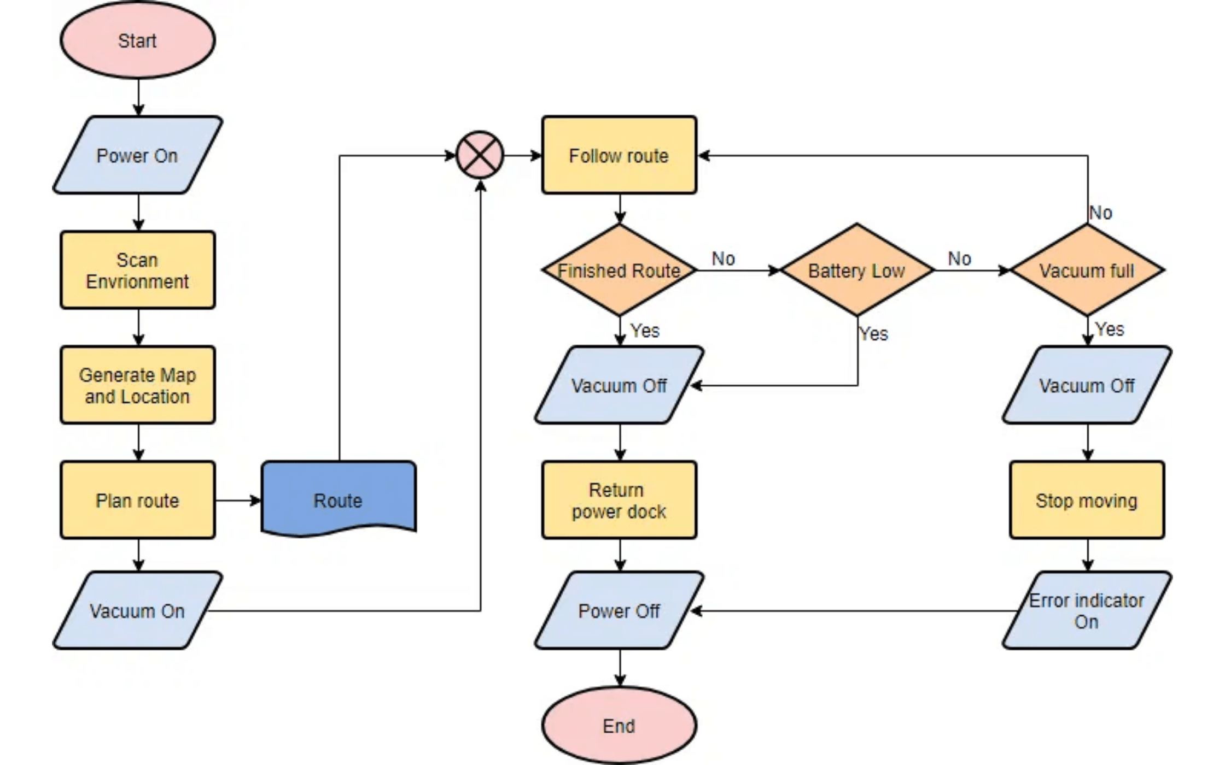
Breaking Down Complex Scientific Problems into Steps
Definition
Algorithmic thinking involves defining a clear, unambiguous sequence of steps to solve a problem or achieve a goal.
Applications
Creating computational models
Analyzing large datasets
Automating experimental procedures
Example: Projectile Trajectory
Step 1: Identify problem and necessary inputs (initial speed, launch angle, gravity). Step 2: Define steps: calculate velocity components, use kinematic equations, determine time of flight, calculate distance. This sequence forms the algorithm.

Slide 4

Decision-Making Logic in Scientific Computing
Definition & Importance
Conditionals allow programs to make decisions based on whether a certain condition is true or false. In science, conditionals are incredibly useful for analyzing data or controlling experiments where outcomes depend on specific criteria.
Application 1
Application 2
Application 3
Data Filtering
Experimental Control
Classification
If a data point falls outside a certain range (e.g., a sensor reading is abnormally high or low), then flag it as an outlier for further investigation, else accept it as valid data.
If the temperature in a reaction vessel exceeds a threshold, then activate a cooling mechanism, else continue heating. This mirrors real-time experimental decision-making.
If a newly discovered species has specific genetic markers, then classify it into a certain genus, else consider other classifications. Automates taxonomic decisions.
If-then-else logic directly mirrors the decision-making processes scientists use when interpreting results or adjusting experimental parameters.

Slide 5
Repetitive Processes and Iterative Analysis
Loops enable programs to repeat a block of code multiple times, which is essential for tasks involving repetitive calculations or processing large datasets in scientific research.
For Loops
While Loops
Definition & Use Case
Definition & Use Case
Used when the number of repetitions is known or can be determined beforehand. Ideal for iterating through each element in a dataset or simulating a process for a predetermined number of time steps.
Used when the number of repetitions is unknown and depends on a condition being met. The loop continues to execute as long as a specified condition remains true.
Scientific Example
Scientific Example
While the chemical reaction has not reached equilibrium, continue monitoring its progress. The loop terminates when equilibrium is detected, regardless of how many iterations were needed.
For each plant in an experiment, measure its height and record the data. The loop executes once for each plant, processing all measurements systematically.
Application
Application
Continue processing data or simulating conditions until a specific criterion is met, such as convergence, equilibrium, or threshold achievement.
Iterate through each measurement in a dataset to calculate an average, or simulate a process for a predetermined number of time steps.
By leveraging loops, scientists can automate complex analyses, run simulations efficiently, and manage large volumes of data with precision. This saves time and reduces human error, leading to more reliable scientific outcomes.

Slide 6

Formalizing Scientific Statements with Symbolic Logic
Definition
Propositional Logic deals with declarative statements (propositions) that are either true or false. Logical connectives are used to combine these statements and express complex scientific ideas.
Connective 1
Connective 2
Connective 3
Conjunction (AND)
Disjunction (OR)
Negation (NOT)
P ∧ Q
P ∨ Q
¬P
Definition
Definition
Definition
True only if both P and Q are true
True if either P or Q (or both) is true
True if P is false; false if P is true
Example
Example
Example
"The temperature is above 0°C AND the pressure is 1 atm"
"The sample is metal OR the sample is an insulator"
"The reaction is NOT exothermic"
Scientific Use
Scientific Use
Scientific Use
Specifying multiple conditions that must all be met simultaneously
Specifying alternative conditions or possibilities
Expressing the absence of a property or condition
Application
Formalizing logical reasoning using propositional logic enhances clarity and rigor, especially when translating scientific hypotheses into computational code.

Slide 7

Expressing General Scientific Laws and Universal Principles
Definition
Predicate Logic extends propositional logic by allowing statements to contain variables and quantifiers, which is more useful for expressing general scientific laws and universal principles that apply across multiple cases.
Concept 1
Concept 2
Concept 3
Predicates
Universal Quantifier (∀)
Existential Quantifier (∃)
Definition
Meaning
Meaning
Properties or relations among variables
FOR ALL: ∀x, P(x) means "For all x, P(x) is true"
THERE EXISTS: ∃x, P(x) means "There exists an x such that
P(x) is true"
Examples
Example
• P(x): "x is a prime number"
• M(x): "x is a mammal"
• R(x,y): "x is related to y"
∀x (If x is a bird, then x has feathers)
Example
∃x (If x is a planet, then x orbits a star)
Classroom Application
Teaching these formal structures helps students understand the logical foundation of scientific hypothesis testing and the structure of complex conditional statements in programming.

Slide 8

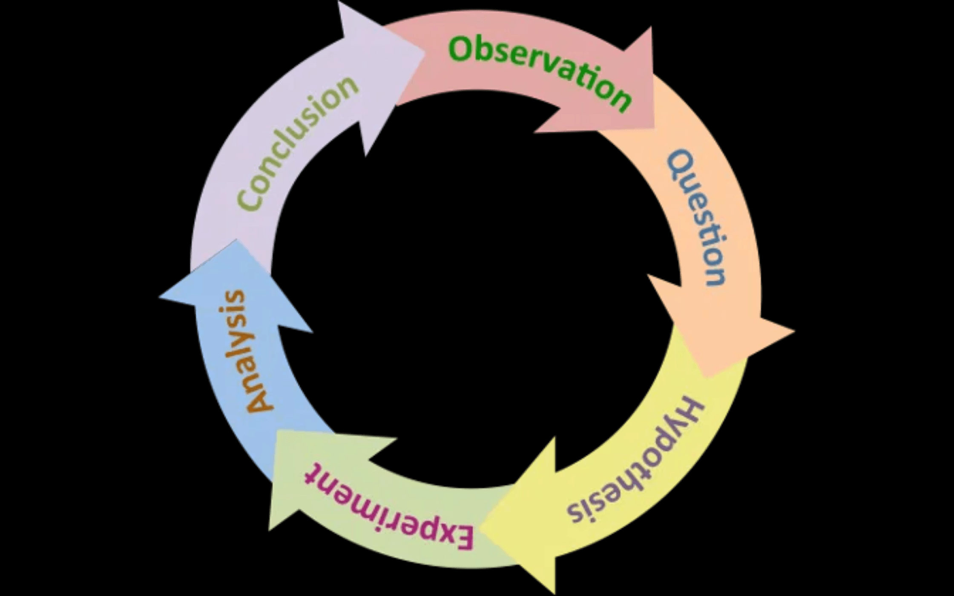
Translating Scientific Logic into Computational Implementation
The Bridge
Logical reasoning provides the foundation for writing effective scientific code that accurately reflects scientific thinking.
Process
Identify the scientific problem and its logical structure
Translate logical statements into conditional and loop structures
Implement using programming language syntax
Test and verify scientifically meaningful results
Example: Temperature Monitoring
Scientific Logic: "While temperature is below target, increase heating. If temperature exceeds threshold, activate cooling."
WHILE (temp < target) THEN heat;
IF (temp > threshold) THEN cool
Key Principle: The logical structure of the problem should directly guide the structure of the code.

Slide 9

Finding and Fixing Logical Errors in Scientific Code
What Are Logical Errors?
Mistakes in the logical structure of code that cause it to produce incorrect results even though it runs without crashing.
Common Logical Errors
Incorrect conditionals (wrong operators: AND instead of OR)
Loops that don't terminate or terminate too early
Missing or misplaced conditions
Incorrect variable assignments or calculations
The Four-Step Debugging Process
Step 1
Step 2
Step 3
Step 4
Decompose
Trace
Test
Verify
Break the problem into smaller components and identify which part is failing.
Follow the code step-by-step to identify where it diverges from expected behavior.
Create test cases with known outcomes to verify each component works correctly.
Ensure the fix produces scientifically meaningful and correct results.
Example: Rock Classification
A program is supposed to identify all rocks that are both igneous AND contain quartz. If it's failing to identify some correct rocks, the logical error might be in the conditional structure (using OR instead of AND, or incorrect comparison operators). Using the four-step process, decompose the problem, trace the conditional logic, test with known rock samples, and verify the fix produces correct classifications.

Slide 10

Popular Programming Languages for Scientific Research
Why Programming Languages Matter: Programming languages provide direct tools for implementing logical structures and solving scientific problems.
Language 1
Language 2
Python
R
Strengths
Strengths
Widely used for data analysis, scientific computing, and machine learning with extensive libraries
Specialized for statistical analysis and data visualization. Popular in biology, ecology, and social sciences.
(NumPy, SciPy, Pandas).
Use Cases
Use Cases
Statistical analysis, data visualization, biological and social science research
Data analysis, visualization, machine learning, general scientific computing
Language 3
Language 4
MATLAB
Java / C++
Strengths
Strengths
Powerful for numerical computing and simulation. Widely used in engineering and physics.
Used for computationally intensive applications and large-scale simulations requiring high performance.
Use Cases
Use Cases
Numerical computing, simulation, engineering and physics applications
High-performance computing, large-scale simulations, complex applications

Slide 11

Selecting the Right Language for Your Classroom
Key Features for Scientific Programming
Clear syntax that mirrors logical reasoning
Extensive libraries for scientific computation
Ability to handle large datasets efficiently
Visualization capabilities for data exploration
Strong community support and documentation
Classroom Approach
Start with a beginner-friendly language like Python, then introduce domain-specific languages as needed. This scaffolded approach allows students to build confidence and competence progressively while maintaining focus on scientific concepts rather than language syntax.
Important Principle
The choice of language should support scientific goals, not constrain them.

Slide 12

Practical Applications and Real-World Examples
Bridging Theory and Practice: The logical reasoning and programming concepts from this chapter are actively used in real scientific research. Here are three compelling examples.
Case Study 1
Case Study 2
Case Study 3
Climate Data Analysis
Genetic Sequence Analysis
Experimental Automation
Context
Context
Context
Climate scientists analyze millions of temperature and
Biologists compare DNA sequences from different organisms to
Laboratory equipment is programmed to run complex
precipitation data points from satellites and ground stations.
identify similarities, mutations, and evolutionary relationships.
experiments automatically, adjusting conditions based on real-
Logical Reasoning
Logical Reasoning
time measurements.
Decompose the data by region and time period. Use loops to
Use pattern recognition to identify matching sequences. Apply
Logical Reasoning
process each data point, conditionals to filter anomalies, and
algorithms to align sequences and calculate similarity scores
Use conditionals and loops to control equipment. If temperature
algorithms to calculate trends.
using conditional logic.
exceeds threshold, activate cooling. While reaction is ongoing,
monitor and record data.
These examples demonstrate how logical reasoning and programming are essential tools in modern scientific research, enabling scientists to solve complex problems efficiently and accurately.

Slide 13

Empowering Students with Logical and Computational Thinking
Key Takeaway 1
Key Takeaway 2
Logical Reasoning is Fundamental
Programming as a Scientific Tool
Logical reasoning—both deductive and inductive—forms the foundation of scientific inquiry and computational problem-solving.
Programming languages allow scientists to implement logical structures, automate analyses, and solve complex problems efficiently.
Key Takeaway 3
Key Takeaway 4
Debugging is Scientific Practice
Computational Thinking in Science
Debugging code mirrors the scientific method: decompose problems, trace logic, test hypotheses, and verify results.
Computational thinking—decomposition, pattern recognition, abstraction, and algorithms—enhances scientific reasoning and problem-solving capabilities.
Educational Impact
By teaching logical reasoning and programming fundamentals, educators equip students with essential skills for modern science, enabling them to tackle complex real-world problems and contribute meaningfully to scientific advancement.
Looking Ahead
Chapter 4 explores how to apply these logical and computational foundations to:
Data Analysis and Visualization

